Slide 1


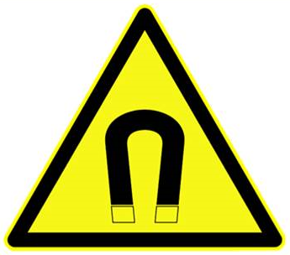
WARNING
Strong Magnetic Fields
No Active Implants
Cardiac pacemaker, defibrillators, hearing aids, insulin pumps, dosage device for medication etc.
No Passive Implants
Metallic objects inside the body, etc.
Not Metal and Ferromagnetic Objects
Lab Safety Representative | Name | 054 – XXX – XXX
Lab Safety Representative (Alternate) | Name | 054 – XXX – XXX

